Slide 1

Data Structures Using C++ 2E
Chapter 8
Queues

Slide 2
Objectives
Learn about queues
Examine various queue operations
Learn how to implement a queue as an array
Learn how to implement a queue as a linked list
Discover queue applications
Become aware of the STL class queue
Queue data structure
  Elements added at one end (rear), deleted from other end (front)
  First In First Out (FIFO)
  Middle elements inaccessible
Data Structures Using C++ 2E

Slide 3
Queue Operations
Two key operations
  addQueue: add to the back of the queue
  deleteQueue: remove from the front of the queue
Additional operations
  initializeQueue, isEmptyQueue, isFullQueue, front, back
queueFront, queueRear pointers
  Keep track of front and rear
See code on pages 453-454
Data Structures Using C++ 2E

Slide 4
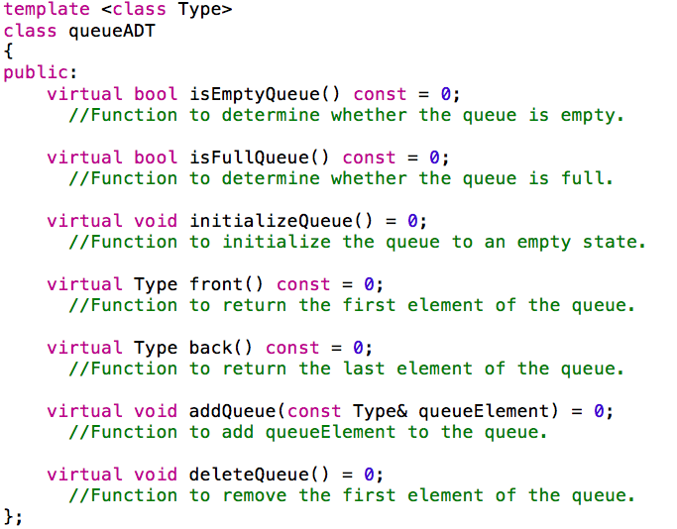
Data Structures Using C++ 2E

Slide 5
Implementation of Queues as Arrays
Four member variables
  Array to store queue elements
  Variables queueFront, queueRear
  Variable maxQueueSize
Using queueFront, queueRear to access queue elements
  queueFront: first queue element index
  queueRear: last queue element index
    queueFront changes after each deleteQueue operation
    queueRear changes after each addQueue operation
Data Structures Using C++ 2E

Slide 6
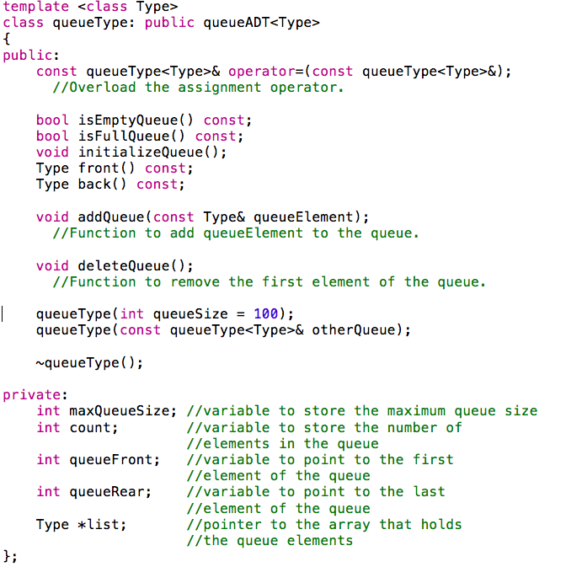
Data Structures Using C++ 2E

Slide 7
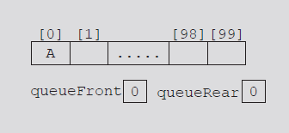
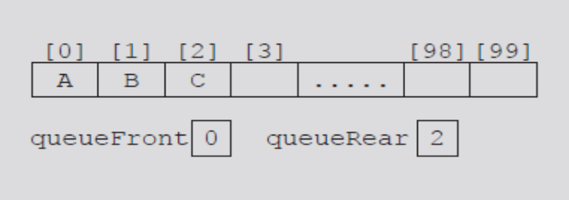
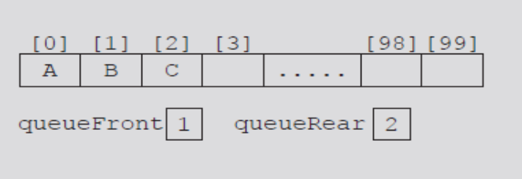
Implementation of Queues as Arrays
(cont’d.)
Execute operation
  Queue.addQueue('A');
Execute
  Queue.addQueue('B');
  Queue.addQueue('C');
Execute
  Queue.deleteQueue();
FIGURE 8-1 Queue after the first addQueue operation
FIGURE 8-2 Queue after two more addQueue operations
FIGURE 8-3 Queue after the deleteQueue operation
Data Structures Using C++ 2E

Slide 8
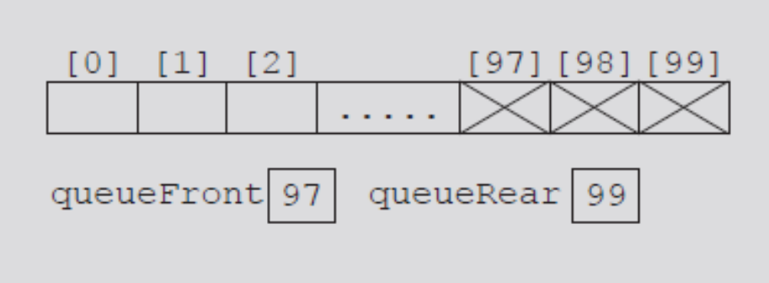
Implementation of Queues as Arrays
(cont’d.)
Consider the sequence of operations: AAADADADADADADADA...
  Eventually index queueRear points to last array position
    Looks like a full queue
    Reality: queue has two or three elements, array empty in the front
FIGURE 8-4 Queue after the sequence
of operations AAADADADADADA...
Data Structures Using C++ 2E

Slide 9
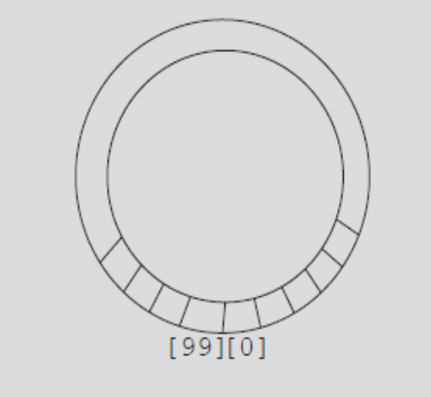
Implementation of Queues as Arrays
(cont’d.)
First solution
  Upon queue overflow to the rear
    Check value of queueFront
    If room in front: slide all queue elements toward first array position
  Works if queue size very small
Second solution: assume circular array
FIGURE 8-5 Circular queue
Data Structures Using C++ 2E

Slide 10
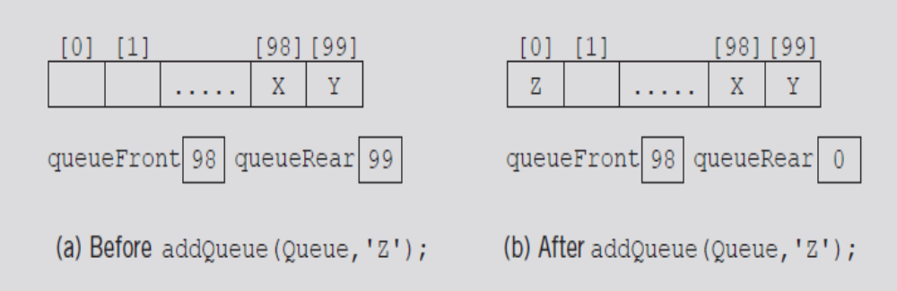
Queue as Circular Array
addQueue
  Advances queueRear (queueFront) to next array position
  queueRear = (queueRear + 1) % maxQueueSize;
FIGURE 8-6 Queue before and after the add operation
Data Structures Using C++ 2E

Slide 11
Queue as Circular Array (cont’d.)
If queueRear < maxQueueSize – 1
  queueRear + 1 <= maxQueueSize – 1
  (queueRear + 1) % maxQueueSize ➔ queueRear + 1
If queueRear == maxQueueSize – 1
  queueRear + 1 == maxQueueSize
  (queueRear + 1) % maxQueueSize ➔ 0
queueRear set to zero
  First array position
Data Structures Using C++ 2E

Slide 12
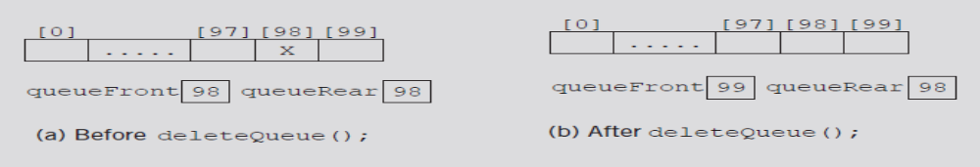
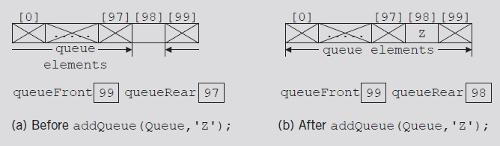
Queue Empty or Full?
Problematic cases with identical queueFront, queueRear values
  Figure 8-7(b) represents an empty queue
  Figure 8-8(b) represents a full queue
FIGURE 8-7 Queue before and after the delete operation
FIGURE 8-8 Queue before and after the add operation
Data Structures Using C++ 2E

Slide 13
Queue Empty or Full? (cont’d.)
First solution: use variable count
  Incremented when new element added
  Decremented when element removed
  Functions initializeQueue, destroyQueue initialize count to zero
See code on pages 459-460
  Uses first solution
Data Structures Using C++ 2E

Slide 14
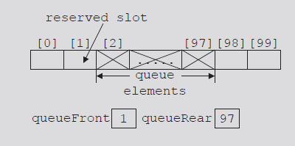
Queue Empty or Full? (cont’d.)
Second solution
  queueFront indicates index of array position preceding first element of the queue
  Assume queueRear indicates index of last element
  Slot indicated by index queueFront is reserved
    If array size is N, max N-1 elements can be stored in queue
  Queue is empty if queueFront == queueRear
  Queue is full if next available space represents special reserved slot
FIGURE 8-9 Array to store the queue
elements with a reserved slot
Data Structures Using C++ 2E

Slide 15
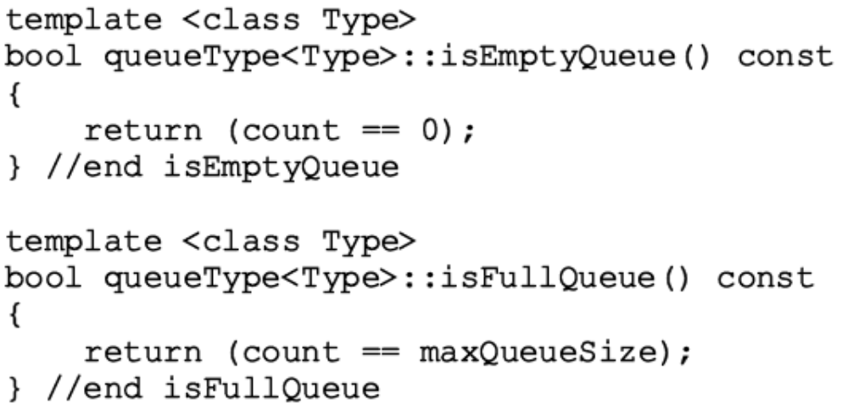
Circular Queue w/ count: Empty Queue and Full Queue
Empty queue
  If count == 0
Full queue
  If count == maxQueueSize
Data Structures Using C++ 2E

Slide 16
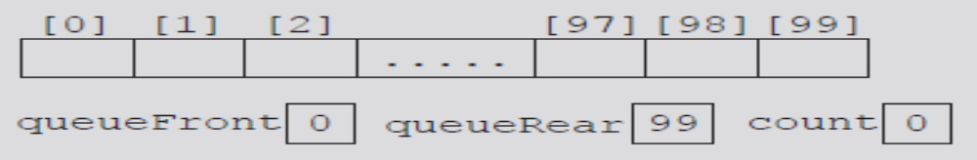
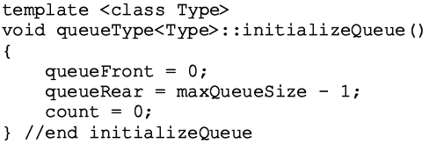
Initialize Queue
Initializes queue to empty state
  First element added at the first array position
  Initialize queueFront to zero, queueRear to maxQueueSize - one, count to zero
FIGURE 8-10 Empty queue
Why?
Data Structures Using C++ 2E
Notes:
Why set queueRear to be maxQueueSize-1? 1st element added at 1st array position

Slide 17
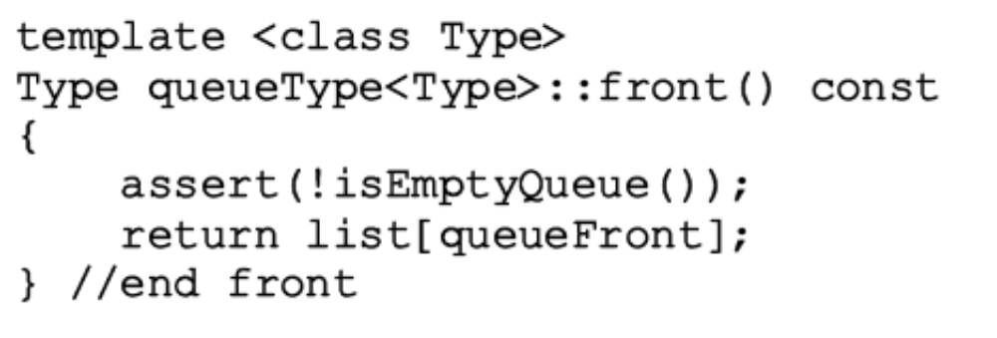
Front
Returns first queue element
  If the queue nonempty
    Element indicated by index queueFront returned
  Otherwise
    Program terminates
Data Structures Using C++ 2E

Slide 18
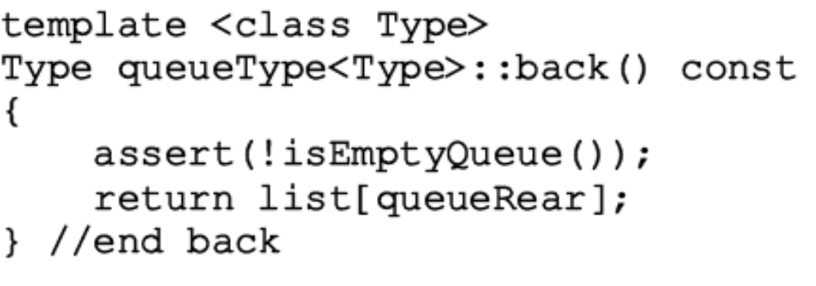
Back
Returns last queue element
  If queue nonempty
    Returns element indicated by index queueRear
  Otherwise
    Program terminates
Data Structures Using C++ 2E

Slide 19
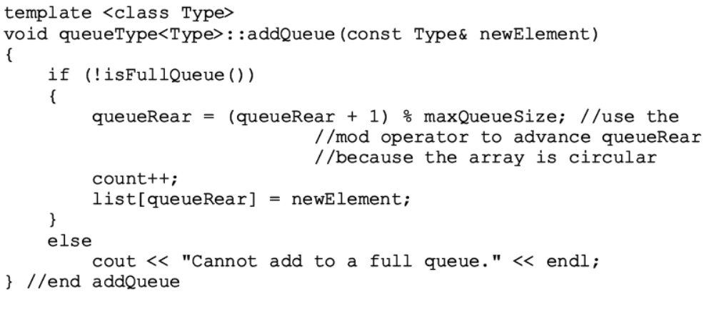
Add Queue
Data Structures Using C++ 2E

Slide 20
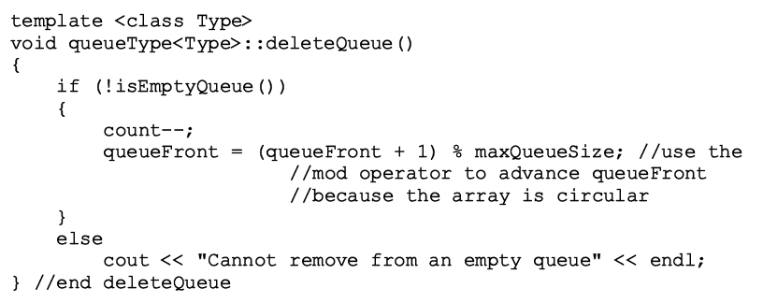
Delete Queue
Data Structures Using C++ 2E

Slide 21
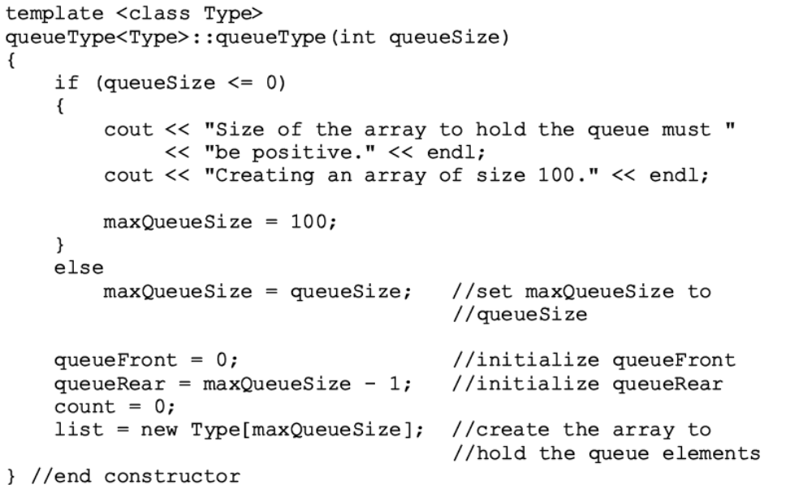
Constructors and Destructors
Data Structures Using C++ 2E

Slide 22
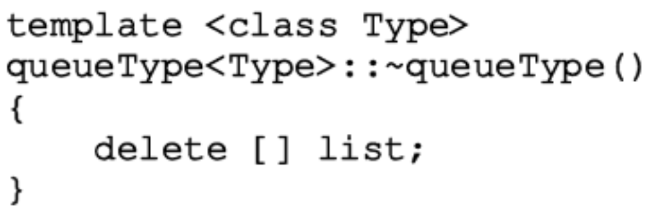
Constructors and Destructors (cont’d.)
Array storing queue elements
  Created dynamically
  When queue object goes out of scope
    Destructor deallocates memory occupied by the array storing queue elements
Exercise: Copy constructor and overloaded assignment operator
Data Structures Using C++ 2E

Slide 23
Array-based Queue: Exercises
Given an empty queue implemented using a static array of 5 elements, what will be the values of queueFront and queueRear, after the code is run? What does the queue look like?
ch = ‘A’
for (int i=1; i<=4; i++)
{
q.addQueue(ch);
ch++;
q.addQueue(ch);
ch=q.front();
q.deleteQueue();
}
Data Structures Using C++ 2E
Notes:
Initially: queueFront=0, queueRear=4
i=1: q.enqueue(‘A’), queueFront=queueRear=0,
ch=‘B’ queueFront=0, queueRear=1,, AB
ch = A
q.dequeue(); queueFront=1, queueRear=1, B
i=2: q.enqueue(A), queueFront=1, queueRear=2,, BA
ch=‘a’
q.enqueue(b) queueFront=1, queueRear=3, BAB
ch=‘B’
q.dequeue(), queueFront=2, queueRear=3, AB
i=3: q.enqueue(‘B’) queueFront=2, queueRear=4, ABB
ch=‘c’
q.enqueue(‘c’) queueFront=2, queueRear=0, ABBC
ch=A
q.dequeue() queueFront=3, queueRear=0, BBC
i=4, q.enqueue(‘A’) queueFront=3, queueRear=1, BBCA
ch=B
q.enqueue(‘b’) queueFront=3, queueRear=2, BBCAB
ch=‘B’
q.dequeue() queueFront=4, queueRear = 2, BCAB

Slide 24
Array-based Queue: w/o count
How to modify the class definition w/ the 2nd solution?
  No member variable count
FIGURE 8-9 Array to store the queue
elements with a reserved slot
Data Structures Using C++ 2E
Notes:
In class declaration: remove count
In isEmptyQueue(): check if queueFront==queueRear
isFullQueue() (queueRear+1)%maxQueueSize == queueFront
InitializeQueue: queueRear=0
Front(): return list[queueFront+1];

Slide 25
Linked Implementation of Queues
Array implementation issues
  Fixed array size
    Finite number of queue elements
  Requires special array treatment with the values of the indices queueFront, queueRear
Linked implementation of a queue
  Simplifies special cases of the array implementation
  Queue never full
See code on pages 464-465
Data Structures Using C++ 2E

Slide 26
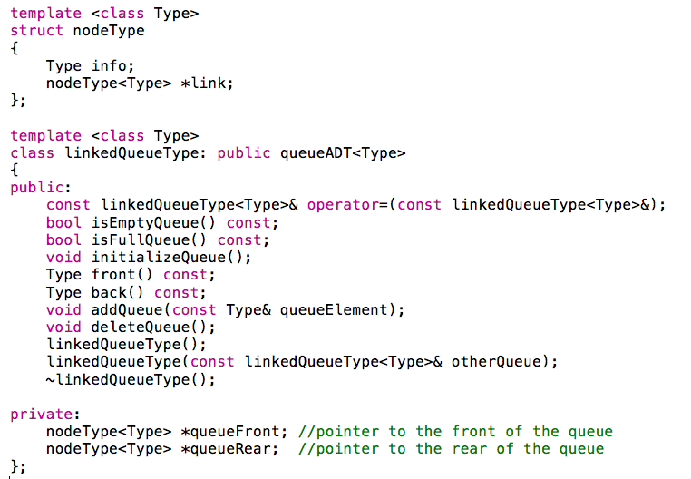
Data Structures Using C++ 2E

Slide 27
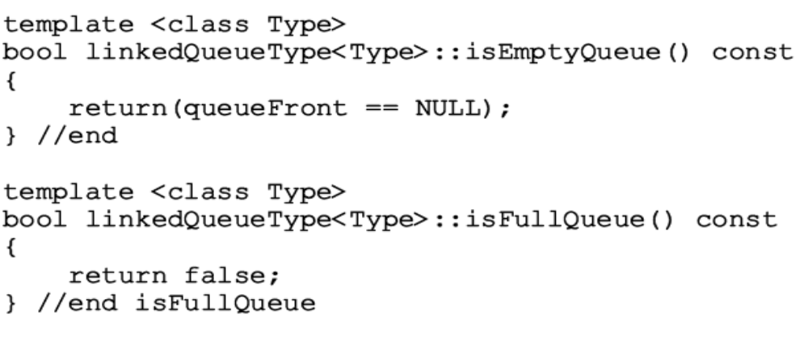
Empty and Full Queue
Empty queue if queueFront is NULL
Memory allocated dynamically
  Queue never full
  Function implementing isFullQueue operation returns the value false
Data Structures Using C++ 2E

Slide 28
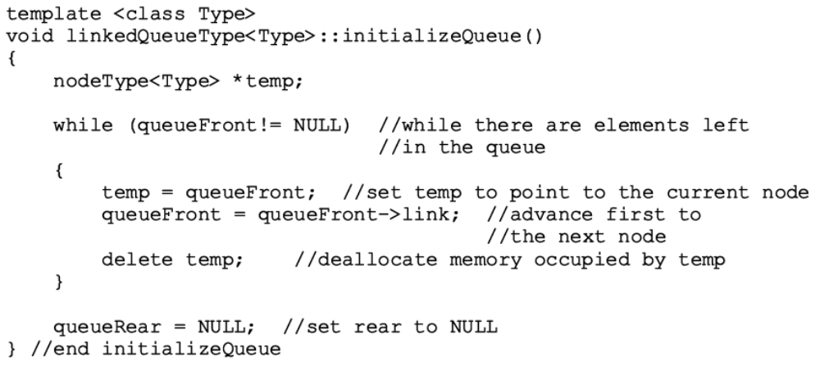
Initialize Queue
Initializes queue to an empty state
  Empty if no elements in the queue
Data Structures Using C++ 2E

Slide 29
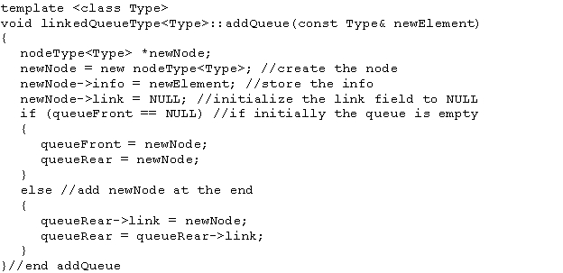
addQueue Operation
addQueue operation adds a new element at end of the queue
  Access the pointer queueRear
Data Structures Using C++ 2E

Slide 30
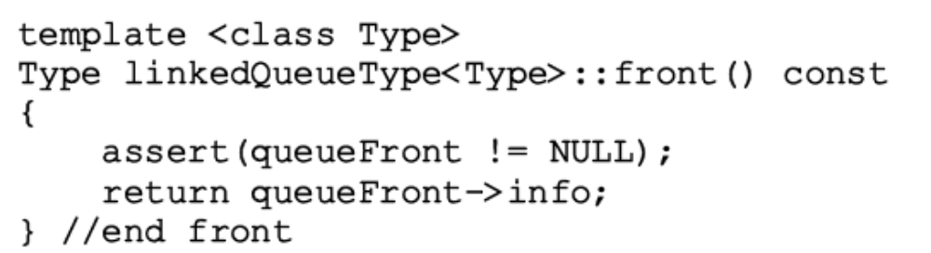
front Operation
If queue nonempty
  Operation front returns first element
  Element indicated queueFront returned
If queue empty: front terminates the program
Data Structures Using C++ 2E

Slide 31
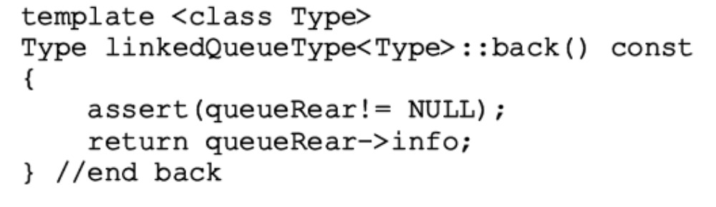
back Operation
If queue nonempty
  Operation back returns last element
  Element indicated by queueRear returned
If queue empty: back terminates the program
Data Structures Using C++ 2E

Slide 32
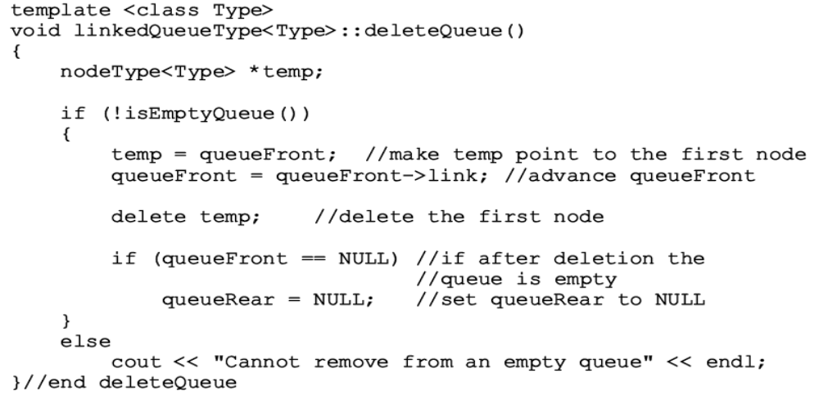
deleteQueue Operation
If queue nonempty
  Operation deleteQueue removes first element
    Access pointer queueFront
Data Structures Using C++ 2E

Slide 33
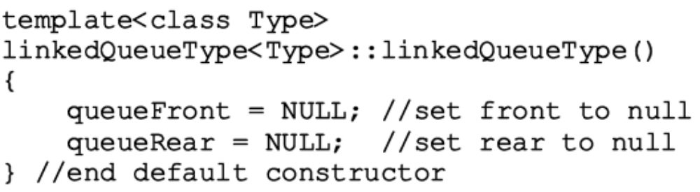
Constructor & destructor
Default constructor
Destructor
  deallocate memory used by elements
  similar to function initializeQueue
Exercise: Copy constructor and overloaded assignment operator
Data Structures Using C++ 2E

Slide 34
Queue Derived from the class unorderedLinkedListType
Linked queue implementation
  Similar to forward manner linked list implementation
  Similar operations
    add Queue, insertFirst
    initializeQueue , initializeList
    isEmptyQueue, isEmptyList
  deleteQueue operation implemented as before
  Same pointers
    queueFront and first, queueRear and last
Data Structures Using C++ 2E

Slide 35
Queue Derived from the class unorderedLinkedListType (cont’d.)
Linked queue implementation (cont’d.)
  Can derive the class to implement the queue from the class linkedListType
  class linkedListType
    An abstract class
    Does not implement all operations
  class unorderedLinkedListType
    Derived from class linkedListType
    Provides definitions of the abstract functions of the class linkedListType
Data Structures Using C++ 2E

Slide 36
STL class queue (Queue Container Adapter)
Standard Template Library (STL)
  Provides a class to implement queues in a program
  Queue
    Name of class defining the queue
    Name of header defining class queue
    #include <queue>
    Provides relational operators comparing two queues
    See Example 8-2
Data Structures Using C++ 2E

Slide 37
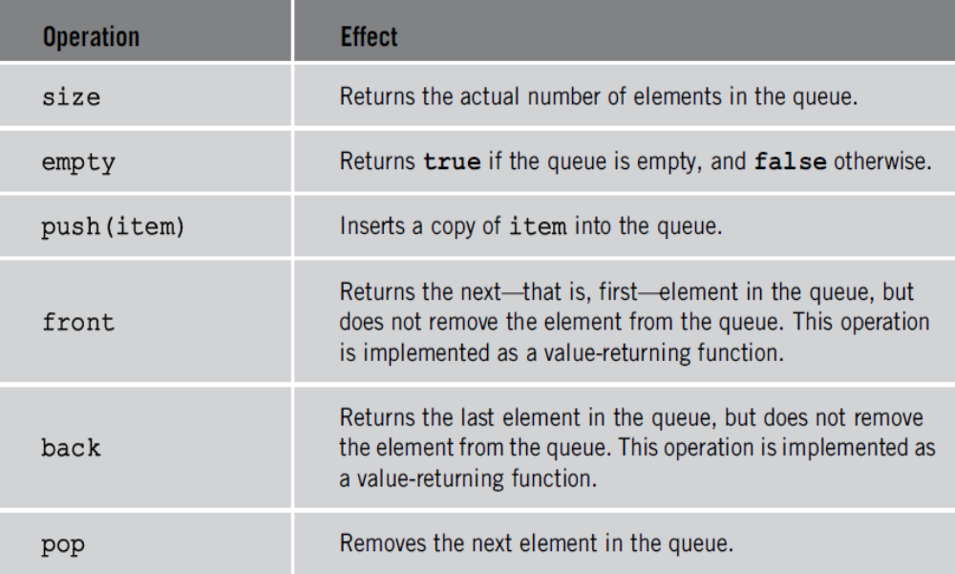
STL class queue (cont’d.)
TABLE 8-1 Operations on a queue object
addQueue
deleteQueue
Data Structures Using C++ 2E

Slide 38
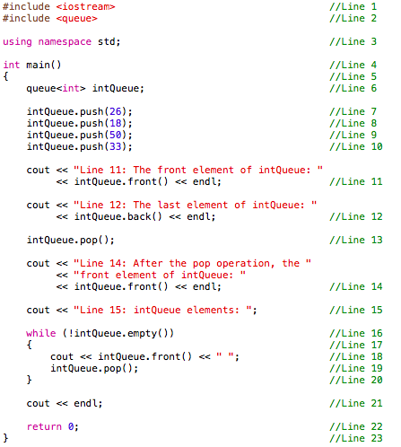

Data Structures Using C++ 2E

Slide 39
Priority Queues
Queue structure ensures items processed in the order received
Priority queues
  Customers (jobs) with higher priority pushed to the front of the queue
Implementation
  Ordinary linked list
    Keeps items in order from the highest to lowest priority
  Treelike structure
    Very effective
    Chapter 10
Data Structures Using C++ 2E

Slide 40
STL class priority_queue
class template priority_queue<elemType>
  Queue element data type specified by elemType
  Contained in the STL header file queue
Specifying element priority
  Default priority criteria for the queue elements
    Less-than operator (<)
  Overloading the less-than operator (<)
    Compare the elements
  Defining a comparison function to specify the priority
Data Structures Using C++ 2E

Slide 41
Application of Queues: Simulation
Simulation
  Technique in which one system models the behavior of another system
Computer simulation
  Represents objects being studied as data
  Actions implemented with algorithms
    Programming language implements algorithms with functions
    Functions implement object actions
Change in simulation results occurs if change in data value or modification of function definitions occurs
Main goal
  Generate results showing the performance of an existing system
  Predict performance of a proposed system
Data Structures Using C++ 2E

Slide 42
Designing a Queuing System
  Example: bank, movie theater, etc
Server
  Object that provides the service
Customer
  Object receiving the service
Transaction time (service time)
  Time required to serve a customer
Queuing system consists of servers, queue of waiting objects
  Model system consisting of a list of servers; waiting queue holding the customers to be served
Data Structures Using C++ 2E

Slide 43
Designing a Queuing System (cont’d.)
Modeling a queuing system: requirements
  Number of servers, expected customer arrival time, time between customer arrivals, number of events affecting system
Time-driven simulation
  Clock implemented as a counter
  Passage of time
    Implemented by incrementing counter by one
Run simulation for fixed amount of time
  Example: run for 100 minutes
    Counter starts at one and goes up to 100 using a loop
Data Structures Using C++ 2E

Slide 44
server list
Num
currentC
busyFree
transTime
currentC
busyFree
transTime
currentC
busyFree
transTime
head
clock
customer Q
Cn
arrivalT
waitT
transT
head
Cn
arrivalT
waitT
transT
customer
generator
Cn
arrivalT
waitT
transT
tail
Cn
arrivalT
waitT
transT

Slide 45
Customer
Has a customer number, arrival time, waiting time, transaction time, departure time
  With known arrival time, waiting time, transaction time
    Can determine departure time (add these three times)
See class customerType code on pages 475-476
  Implements customer as an ADT
Member function definitions
  Functions setWaitingTime, getArrivalTime, getTransactionTime, getCustomerNumber
    Left as exercises
Data Structures Using C++ 2E

Slide 46
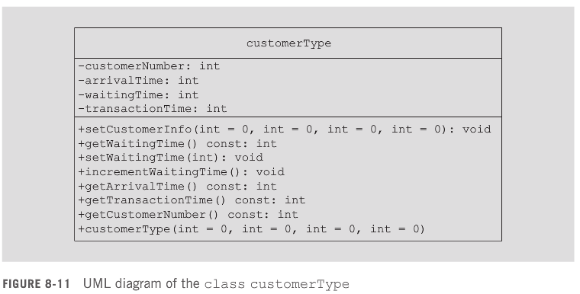
Data Structures Using C++ 2E

Slide 47
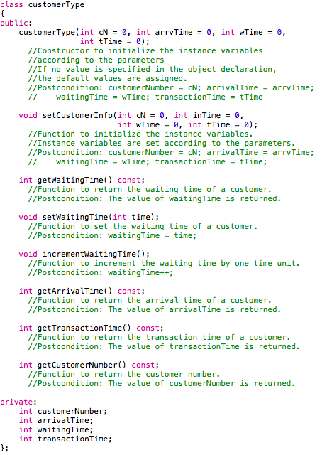
Data Structures Using C++ 2E

Slide 48
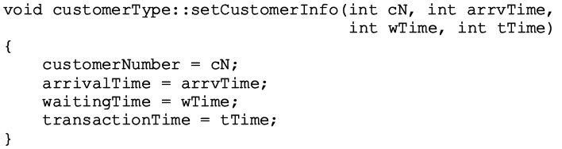
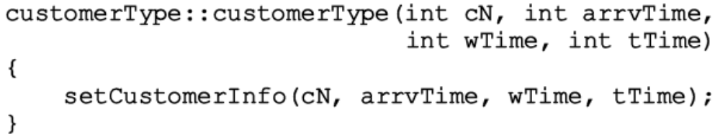
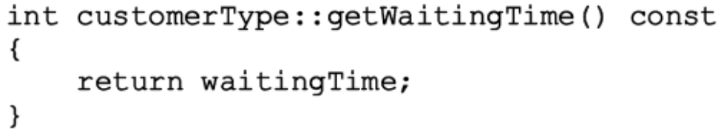
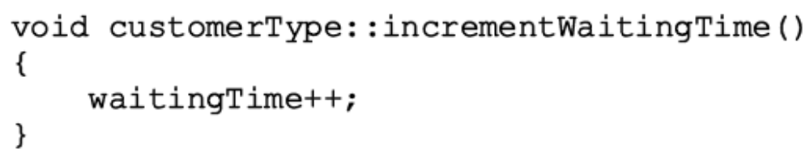
Data Structures Using C++ 2E

Slide 49
Server
At any given time unit
  Server either busy serving a customer or free
String variable sets server status
Every server has a timer
Program might need to know which customer served by which server
  Server stores information of the customer being served
Three member variables associated with a server
  status, transactionTime, currentCustomer
Data Structures Using C++ 2E

Slide 50
Server (cont’d.)
Basic operations performed on a server
  Check if server free
  Set server as free
  Set server as busy
  Set transaction time
  Return remaining transaction time
  If server busy after each time unit
    Decrement transaction time by one time unit
See class serverType code on page 477
  Implements server as an ADT
Member function definitions
Data Structures Using C++ 2E

Slide 51
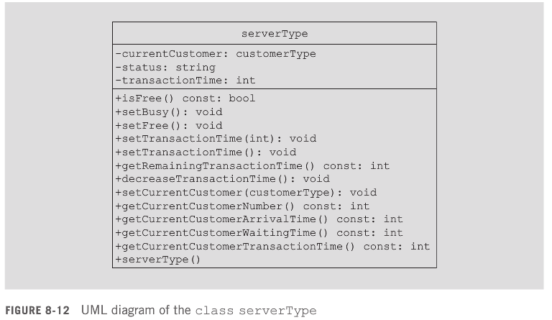
Data Structures Using C++ 2E

Slide 52
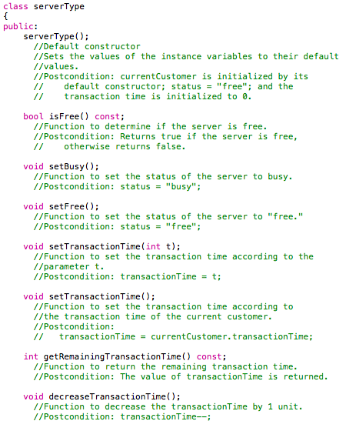
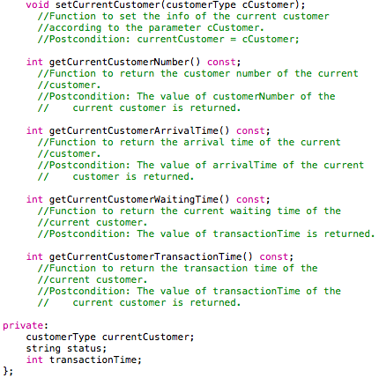
Data Structures Using C++ 2E

Slide 53
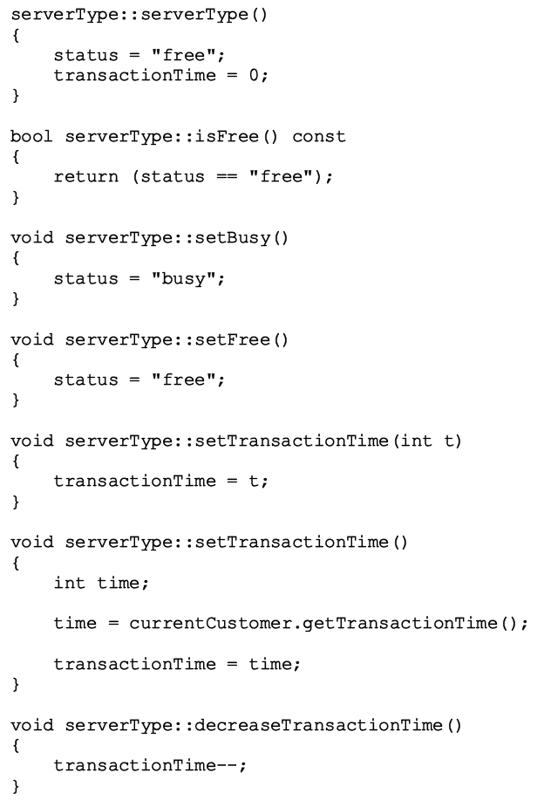
Data Structures Using C++ 2E

Slide 54
Server List
Set of servers
class serverListType
  Two member variables
    Store number of servers
    Maintain a list of servers
  List of servers created during program execution
  Several operations must be performed on a server list
  See class serverListType code on page 481
    Implements the list of servers as an ADT
  Definitions of member functions
Data Structures Using C++ 2E

Slide 55
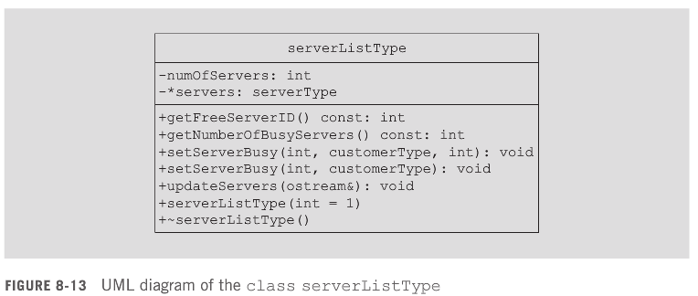
Data Structures Using C++ 2E

Slide 56
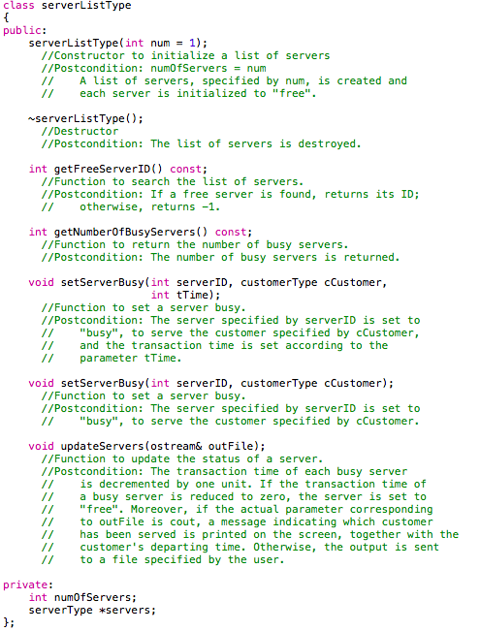
Data Structures Using C++ 2E

Slide 57
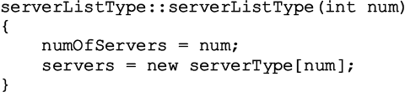
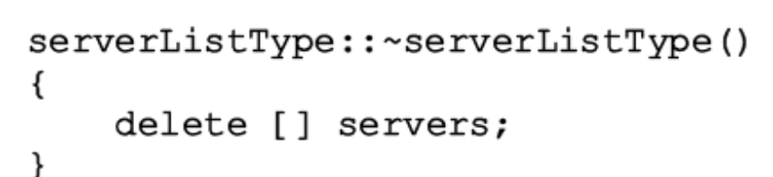
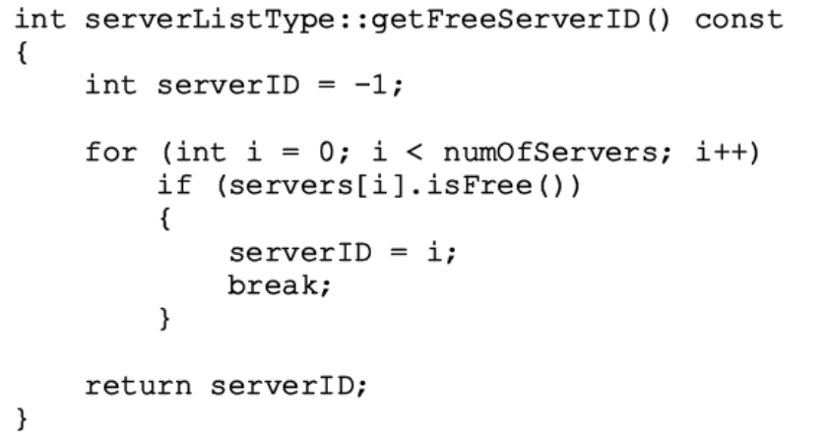
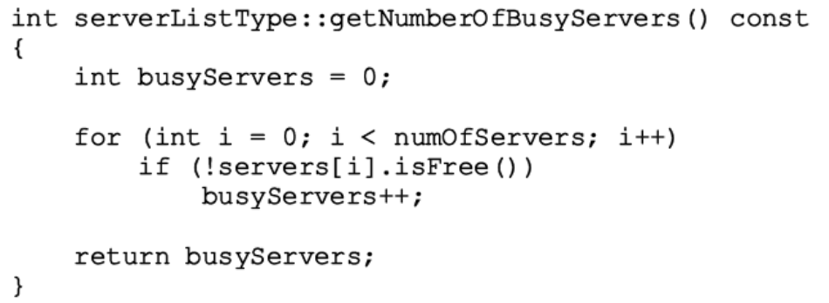
Data Structures Using C++ 2E

Slide 58
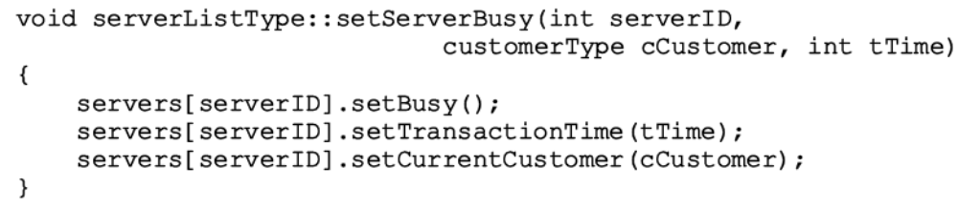
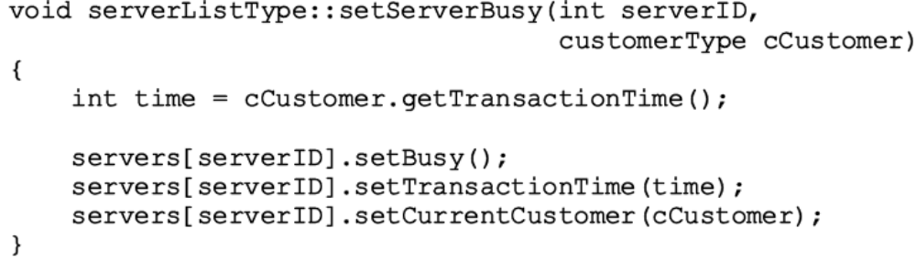
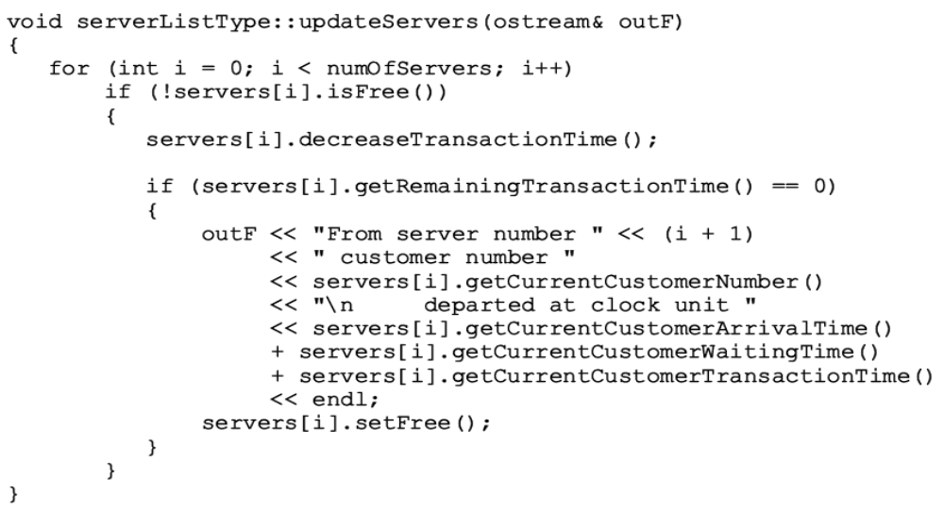
Data Structures Using C++ 2E

Slide 59
Waiting Customers Queue
Upon arrival, customer goes to end of queue
  When server available
    Customer at front of queue leaves to conduct transaction
  After each time unit, waiting time incremented by one
Derive class waitingCustomerQueueType from class queueType
  Add additional operations to implement the customer queue
  See code on page 485
Data Structures Using C++ 2E

Slide 60
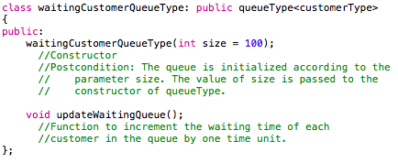

Data Structures Using C++ 2E

Slide 61
Main Program
Run the simulation
  Need information (simulation parameters)
    Number of time units the simulation should run
    The number of servers
    Transaction time
    Approximate time between customer arrivals
  Function setSimulationParameters
    Prompts user for these values
    See code on page 487
Data Structures Using C++ 2E

Slide 62

Main Program (cont’d.)
General algorithm to start the transaction
Data Structures Using C++ 2E

Slide 63
queue<customerType> customerQueue;
serverListType serverList(numberOfServers);
for (clock = 1; clock <= simulationTime; clock++)
{
serverList.updateServers(cout);
if (!customerQueue.empty()) updateCustQueue(customerQueue);
if (isCustomerArrived(timeBetweenCustomerArrival))
{
custNumber++;
customer.setCustomerInfo(custNumber,clock,0, transactionTime);
customerQueue.push(customer);
}
serverID = serverList.getFreeServerID();
if (serverID != -1 && !customerQueue.empty())
{
customer = customerQueue.front();
customerQueue.pop();
serverList.setServerBusy(serverID, customer);
}
}
set up data structure
check server, check cQ
add new arrival
if server free, assign new customer

Slide 64

Main Program (cont’d.)
Use the Poisson distribution from statistics
  Probability of y events occurring at a given time
    Where λ is the expected value that y events occur at that time
  P(0) = e^{-λ} : probability that no one arrives
  1 – P(0) = 1 - e^{-λ} : probability that some customers arrive
  We approximate 1 – P(0) to be probability of exactly one customer arrive, since multiple customers arrival probability is negligible
Function runSimulation implements the simulation
  Function main is simple and straightforward
    Calls only the function runSimulation
Data Structures Using C++ 2E

Slide 65


Data Structures Using C++ 2E

Slide 66
Summary
Queue
  First In First Out (FIFO) data structure
  Implemented as array or linked list
  Linked lists: queue never full
Standard Template Library (STL)
  Provides a class to implement a queue in a program
Priority Queue
  Customers with higher priority pushed to the front
Simulation
  Common application for queues
Data Structures Using C++ 2E

Slide 67
Self Exercises
Programming Exercises: 1, 2, 4, 6, 7
Data Structures Using C++ 2E

